Slide 1
Home Loan Defaults Prediction Models
C

Slide 2
Data
The dataset consisted of the details of 81,682 borrowers.
Only 762 of these were defaulters
The percentage of defaulters - only 0.93 percent
“Skewed dataset” problem. Because of the skewness in the data, the data mining algorithms tend to focus on the majority class and be overwhelmed by the non defaulters
Used a combination of both under sampling and over sampling

Slide 3
Methodology
An elaborate methodology was evolved in order to ensure that
the results of the analysis were repeatable and reproducible
correcting for the skewness of dataset
The entire dataset was divided into defaulters and non defaulters.
Two hundred observations of the defaulters were randomly selected to form the test data
The remaining 562 observations were set aside to form part of the training dataset.

Slide 4
Methodology – Training Dataset
Five non overlapping samples of 15,240 observations each were selected from the non defaulters dataset.
This formed the under sampling part of the methodology.
Each of these non overlapping samples was further subdivided into two subsets.
The first subset consisted of 11,430 observations and the second consisted of the remaining 3,810 observations.
Five different training datasets were created by combining each of the subsets of 11,430 observations of non defaulters with the 562 observations of the defaulters.
Over sampling was achieved by repeating the 562 observations of the defaulters four times within the training dataset.

Slide 5
Methodology – Testing Dataset
Five testing datasets were created by combining each of the 3,810 non overlapping observations of non defaulters with the subset of 200 observations of the defaulters.

Slide 6
Model Evaluation
Predictions fall into 4 categories
The first category is called the True Positives (TP) consisting of the defaulters that were correctly predicted as defaulters by the model.
The second category is the True Negatives (TN) which consist of those non defaulters who were correctly predicted as non defaulters.
False Positives (FP) FP are those non defaulters who were wrongly classified as defaulters by the model.
False Negatives (FN) FN are those defaulters who were misclassified by the model as non defaulters.

Slide 7
Implications
It is important to minimize the FP and FN.
High percentage of FP imply large number of non defaulters misclassified as defaulters resulting in more diligent follow-up which, in turn, will lead to unnecessary expenditure to the company.
High percentage of FN will result in paying less attention to the potential defaulters and consequently lead to a higher default rate
In the same token, it is important to maximize the TP and TN. Needless to say, maximizing TP and TN will automatically lead to minimizing FP and FN

Slide 8
Sample Profile
 |  | PA | NPA | PA | NPA
Gender |  | 1116 | 158 | 1.38 | 20.73
 | FEMALE | 18364 | 80 | 22.69 | 10.50
 | MALE | 61351 | 522 | 75.82 | 68.50
 | Others | 89 | 2 | 0.11 | 0.26
 | Total | 80920 | 762 | 100.00 | 100.00
Borrower Type |  | 1403 | 55 | 1.73 | 7.22
 | Agriculture | 27 | 0 | 0.03 | 0.00
 | Business | 6408 | 34 | 7.92 | 4.46
 | House Wife | 2342 | 13 | 2.89 | 1.71
 | NULL | 1178 | 12 | 1.46 | 1.57
 | Others | 584 | 6 | 0.72 | 0.79
 | Professional | 1032 | 7 | 1.28 | 0.92
 | Retired | 496 | 4 | 0.61 | 0.52
 | Salaried | 31937 | 38 | 39.47 | 4.99
 | Self Employed | 1209 | 62 | 1.49 | 8.14
 | Service | 33810 | 527 | 41.78 | 69.16
 | Staff | 82 | 0 | 0.10 | 0.00
 | STUDENT | 89 | 0 | 0.11 | 0.00
 | Unemployed | 323 | 4 | 0.40 | 0.52

Slide 9
Sample Profile
 |  | PA | NPA | PA | NPA
Purpose Corrected |  | 7268 | 67 | 8.98 | 8.79
 | Addition | 9549 | 132 | 11.80 | 17.32
 | Balance | 1165 | 1 | 1.44 | 0.13
 | Construction | 29912 | 206 | 36.96 | 27.03
 | Others | 2765 | 11 | 3.42 | 1.44
 | Purchase | 21795 | 277 | 26.93 | 36.35
 | Repairs | 5335 | 38 | 6.59 | 4.99
 | Upgrade | 3131 | 30 | 3.87 | 3.94
Refinance from NHB | N | 18437 | 530 | 22.78 | 69.55
 | Y | 62483 | 232 | 77.22 | 30.45
Gender of Co-applicant |  | 25291 | 549 | 31.25 | 72.05
 | Female | 36319 | 151 | 44.88 | 19.82
 | Male | 19285 | 62 | 23.83 | 8.14
 | Others | 25 | 0 | 0.03 | 0.00

Slide 10
Sample Profile
 |  | PA | NPA | PA | NPA
Region |  | 974 | 1 | 1.20 | 0.13
 | 0 | 5454 | 158 | 6.74 | 20.73
 | 1 | 7425 | 55 | 9.18 | 7.22
 | 2 | 5690 | 63 | 7.03 | 8.27
 | 3 | 3031 | 52 | 3.75 | 6.82
 | 4 | 7749 | 122 | 9.58 | 16.01
 | 5 | 30957 | 197 | 38.26 | 25.85
 | 6 | 18675 | 105 | 23.08 | 13.78
 | 7 | 592 | 4 | 0.73 | 0.52
 | 8 | 331 | 5 | 0.41 | 0.66
 | 9 | 42 | 0 | 0.05 | 0.00
Type of Location |  | 30246 | 105 | 37.38 | 13.78
 | Metro | 1626 | 20 | 2.01 | 2.62
 | NA | 1087 | 9 | 1.34 | 1.18
 | Rural | 18179 | 194 | 22.47 | 25.46
 | Semi Urban | 5849 | 40 | 7.23 | 5.25
 | Urban | 23933 | 394 | 29.58 | 51.71

Slide 11
Hybrid Model
CART
 | Prediction
Actual | Non defaulters | Defaulters | Total
Non defaulters | 11074 | 356 | 11430
Defaulters | 940 | 1870 | 2810
Total | 12014 | 2226 | 14240
C 5.0
Actual | Non defaulters | Defaulters | Total
Non defaulters | 11021 | 53 | 11074
Defaulters | 35 | 905 | 940
Total | 11056 | 958 | 12014

Slide 12
Results
Dataset | TN | FN | FP | TP
 | Training datasets
Sample 1 | 96.42 | 3.58 | 1.25 | 98.75
Sample 2 | 94.22 | 5.78 | 0.89 | 99.11
Sample 3 | 94.38 | 5.62 | 1.25 | 98.75
Sample 4 | 94.45 | 5.55 | 1.25 | 98.75
Sample 5 | 96.24 | 3.76 | 1.42 | 98.58
 | Testing Datasets
Sample 1 | 94.86 | 5.14 | 30.00 | 70.00
Sample 2 | 92.68 | 7.32 | 22.50 | 77.50
Sample 3 | 92.97 | 7.03 | 28.00 | 72.00
Sample 4 | 92.23 | 7.77 | 24.50 | 75.50
Sample 5 | 93.96 | 6.04 | 37.00 | 63.00

Slide 13
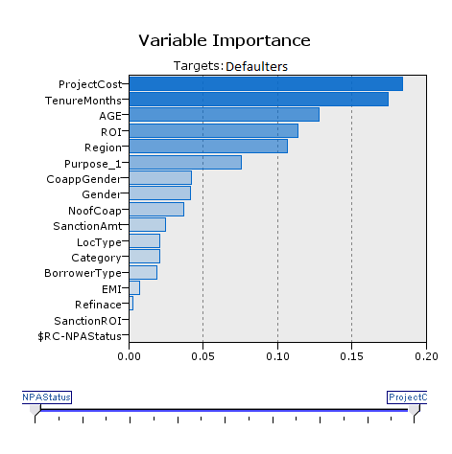
Variable Importance – C5.0

Slide 14
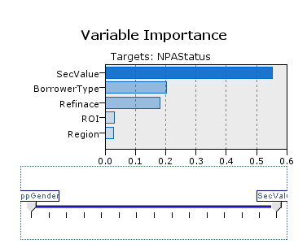
Variable Importance – CART

Slide 15
Questions?
Suggestions?
Comments?

